Slide 1
Why I Think Indexes Are Better Than Search
My students tell me that a Google search is the very best tool to explore the knowledge universe and find what is most interesting to them out there.
But when it comes to a deep dive into a problem, there is no substitute for a well-indexed textbook in their hands.
When they finally write up their work, they go back to search the Internet to find the very latest state of their problem.
Will a well-curated digital index be a standard part of online textbooks in the future? Can online books have "real" page numbers that match the print editions? Amazon does not think so.
A word or phrase in a multi-level index means so much more than a search result pointing to a page. It carries with it a deep semantic context about the place of a specific meme in a semantic web.
Contact me
At Harvard: rodoyle@fas.harvard.edu
At I-Phi Press: bobdoyle@informationphilosopher.com

Slide 2
How I Built Tools To Write My Books
In 1984 I wrote the first Desktop Publishing Program, called MacPublisher, for the then new Apple Macintosh.
I also wrote MacIndexer and MacHyphen.
I hoped at that time to publish books on philosophy and physics.
But I procrastinated for 25 years before getting back to my books!
In the meantime, QuarkXpress and Adobe InDesign developed excellent hyphenation and indexing tools.
Over the years, I researched Content Management, Information Architecture, Multilingual Tools, Web Publishing, Taxonomies, Controlled Vocabularies - all to learn how to build a better website.
I also became a journalist to write about what I was learning.

Slide 3
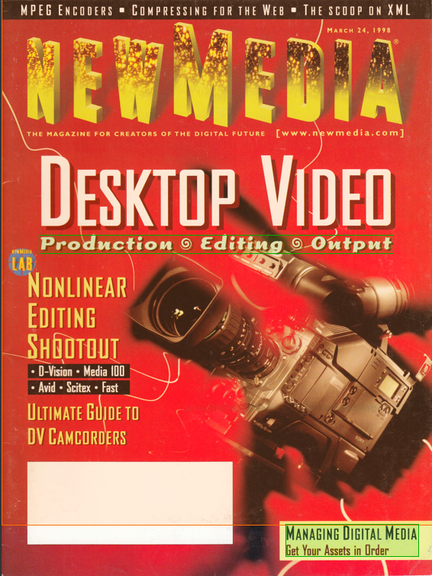
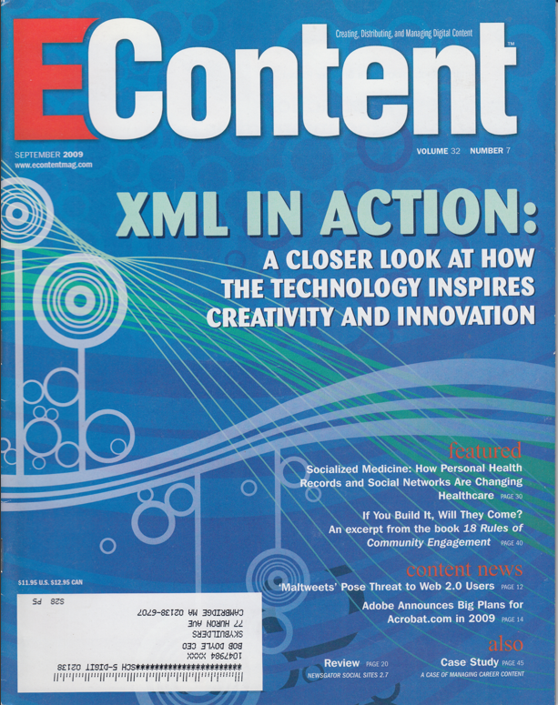
My Writing on Digital Content
Desktop Video Editor - New Media
Regular Columnist - EContent

Slide 4
My Writing on Technical Communication

Slide 5
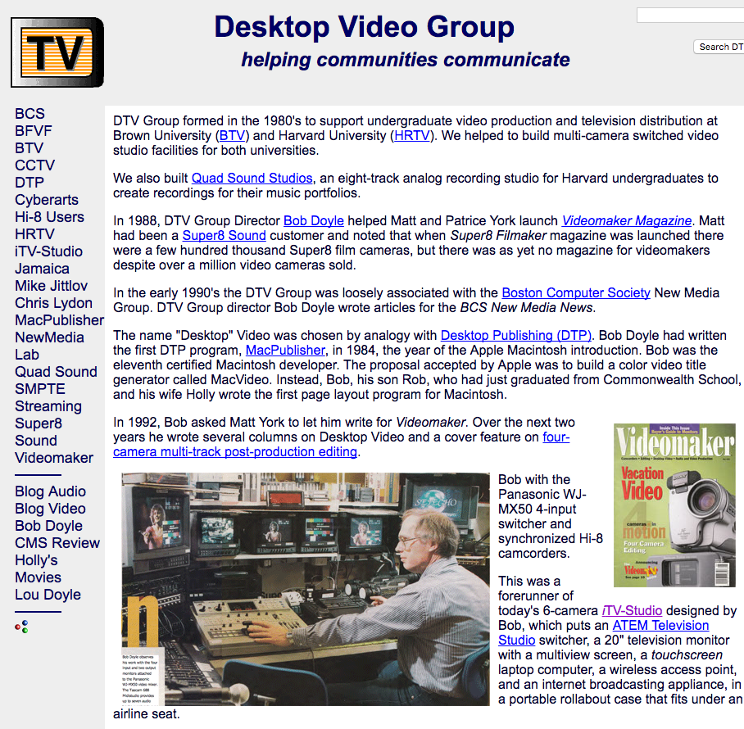
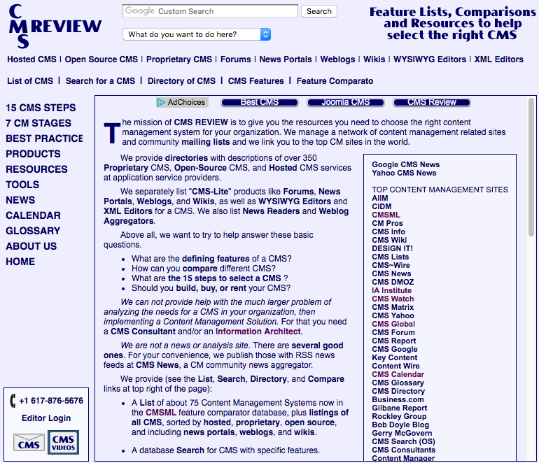
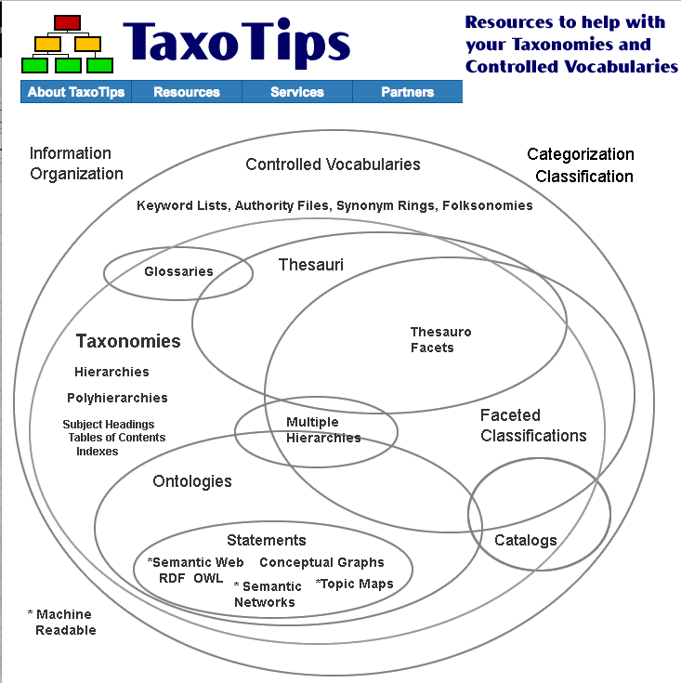
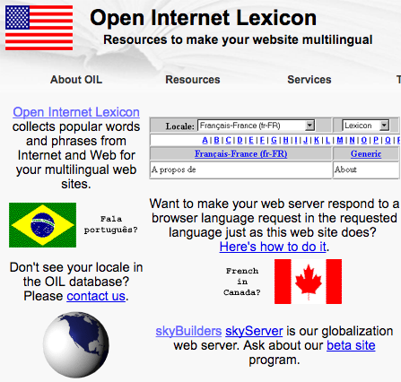
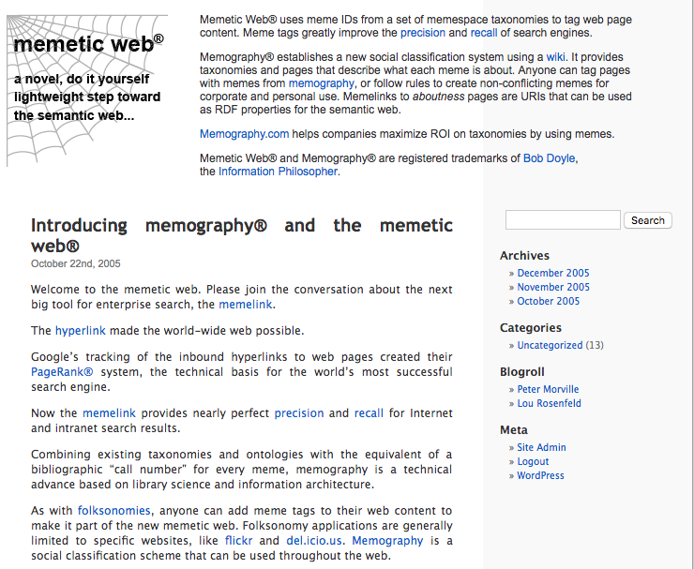
My Web Resource Sites

Slide 6
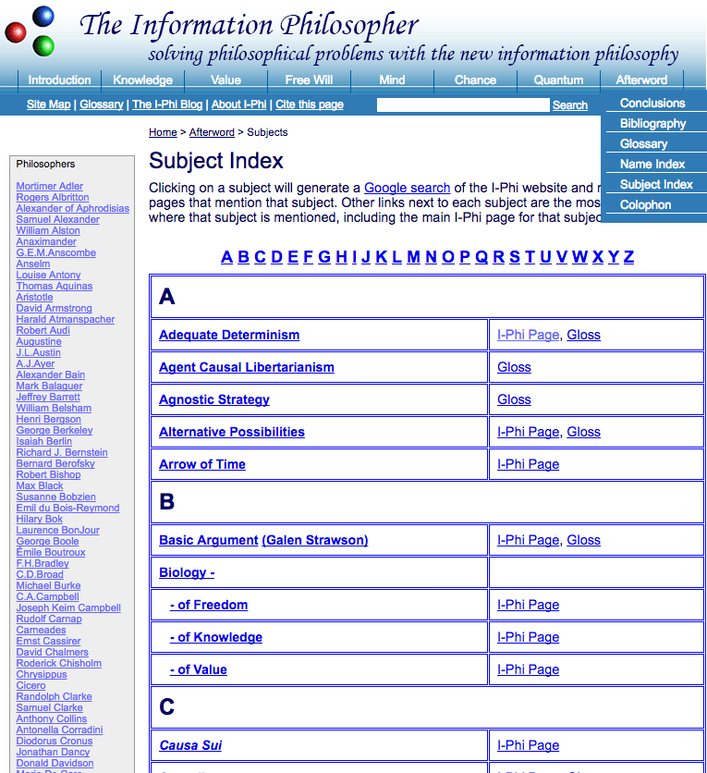
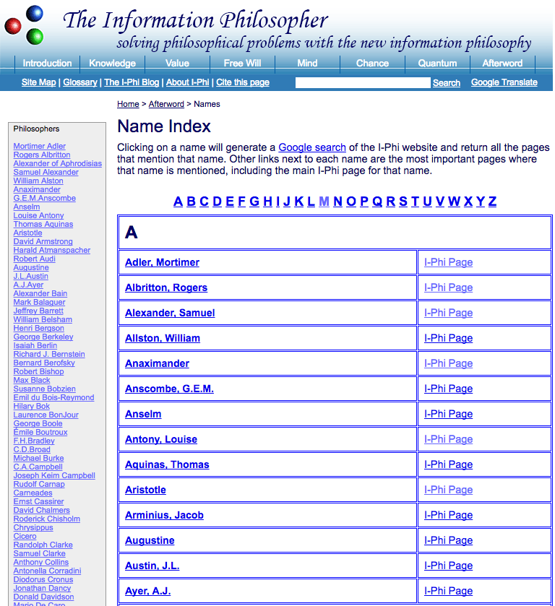
My Subject and Name Indexes

Slide 7
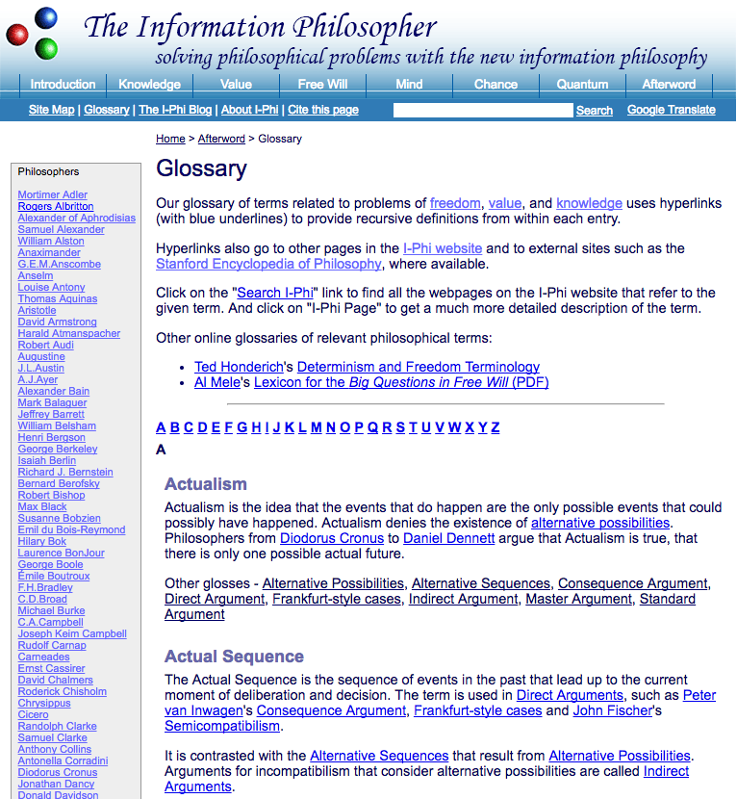
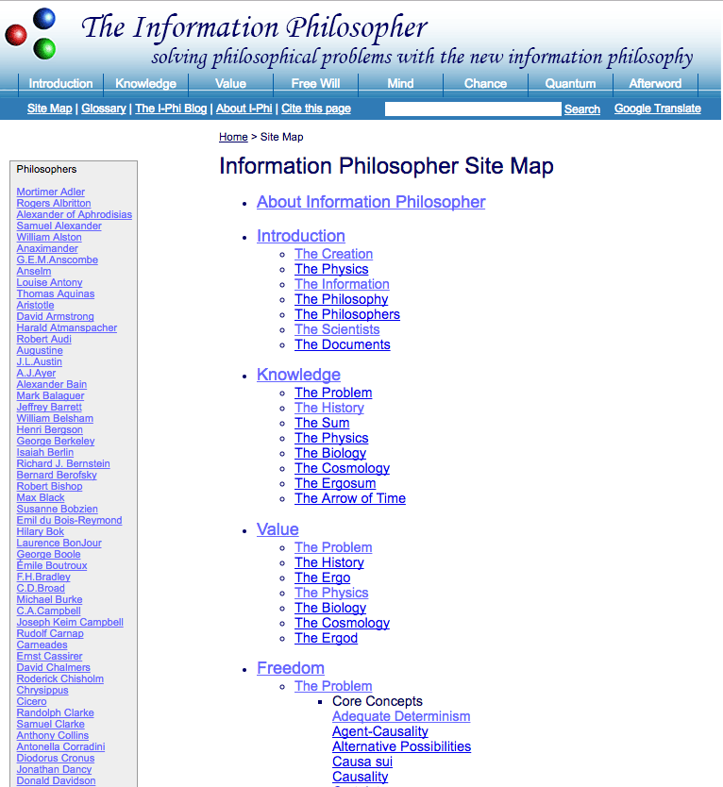
My Glossary and Site Map

Slide 8
In 2010 I started converting some of the many web pages
on my Information Philosopher website into my first book -
Free Will: The Scandal in Philosophy.
But when I converted my book to an Amazon Kindle eBook,
I found that all the page numbers had vanished!

Slide 9
Fixed Layout versus Reflowable EPUBS
In a Fixed-Layout EPUB all the page numbers are preserved. A hyperlinked index and table of contents is produced that allows the reader to jump to the exact page references.
Most EPUBS are FXL -Amazon Kindle Fire, Apple iBooks, Barnes & Noble Nook, Google Books, Kobo eReader, Sony Reader, etc.
However, this is not the case for Amazon Kindle Reflowable "E-Ink" eBooks. Amazon uses the old .mobi format and they strip out some page numbers when converting to their reflowable Kindle eBook format.
Many Amazon Kindle eReaders, notably older tablets and the popular PaperWhite do not normally support "real page numbers.”
This is the problem I solved in 2011, two years before the EPUB3 Indexes Specification of the ASI DTTF Group, now a part of the W3C.

Slide 10
Amazon’s Page Number Policy
9.3.10 Page Number Guidelines
Kindle books do not always map directly to page numbers in physical editions of the book. Even if the Kindle Real Page Numbers feature is activated in the Go To menu, references within the eBook to page numbers should be handled as follows:
• Table of contents: If there are page numbers in the print source’s TOC, they should be removed in the digital conversion. The name of the section should be retained and hyperlinked to the relevant location in the eBook. For example, if a print source TOC displays the entry “Chapter 1 ... P. 36”, then the eBook should only display “Chapter 1” hyperlinked to the correct digital location.
• Internal links: If there is text that refers to another page in the eBook, such as “see page XX”, this text should be linked to the relevant paragraph within the eBook.
• Index: Every page number in the index should be linked to the relevant paragraph in the eBook (or the relevant illustration, table, or chart).
• Links within index: If there is an entry that references another section of the index, such as “see also XXX”, this text should be linked to the relevant section within the index.

Slide 11
How I Added Real Page Numbers
When InDesign exports an EPUB3 file, you can choose either Fixed Layout or Reflowable. If you choose reflowable, all the page numbers are removed. The file contains continuous text, with no page breaks.
All the InDesign elements like chapter headings and automatic page numbering are also removed.
For my 2011 eBook Free Will, I opened the file and inserted 480 little gifs with page numbers at appropriate places between paragraphs
When KDP converted a Reflowable version, Index entries were properly hyperlinked to appropriate paragraphs in the text.
Most important, all the “real” page numbers appeared
in the correct places in the Kindle eBook.
Sadly, the structured Table of Contents was replaced with
a long linear list of content entries.

Slide 12
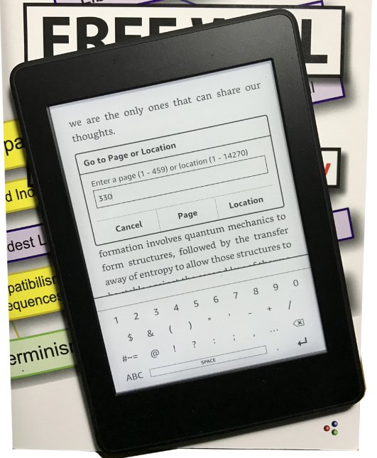
The Kindle “Go To Page” Feature

Slide 13
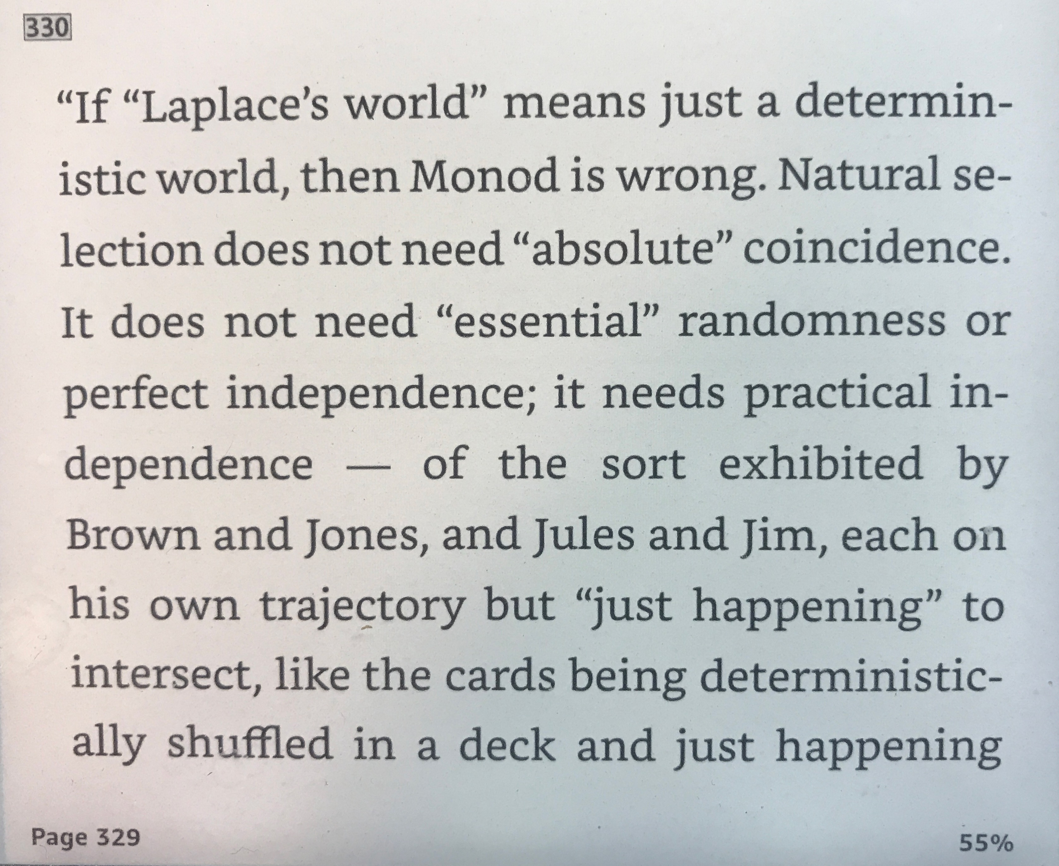
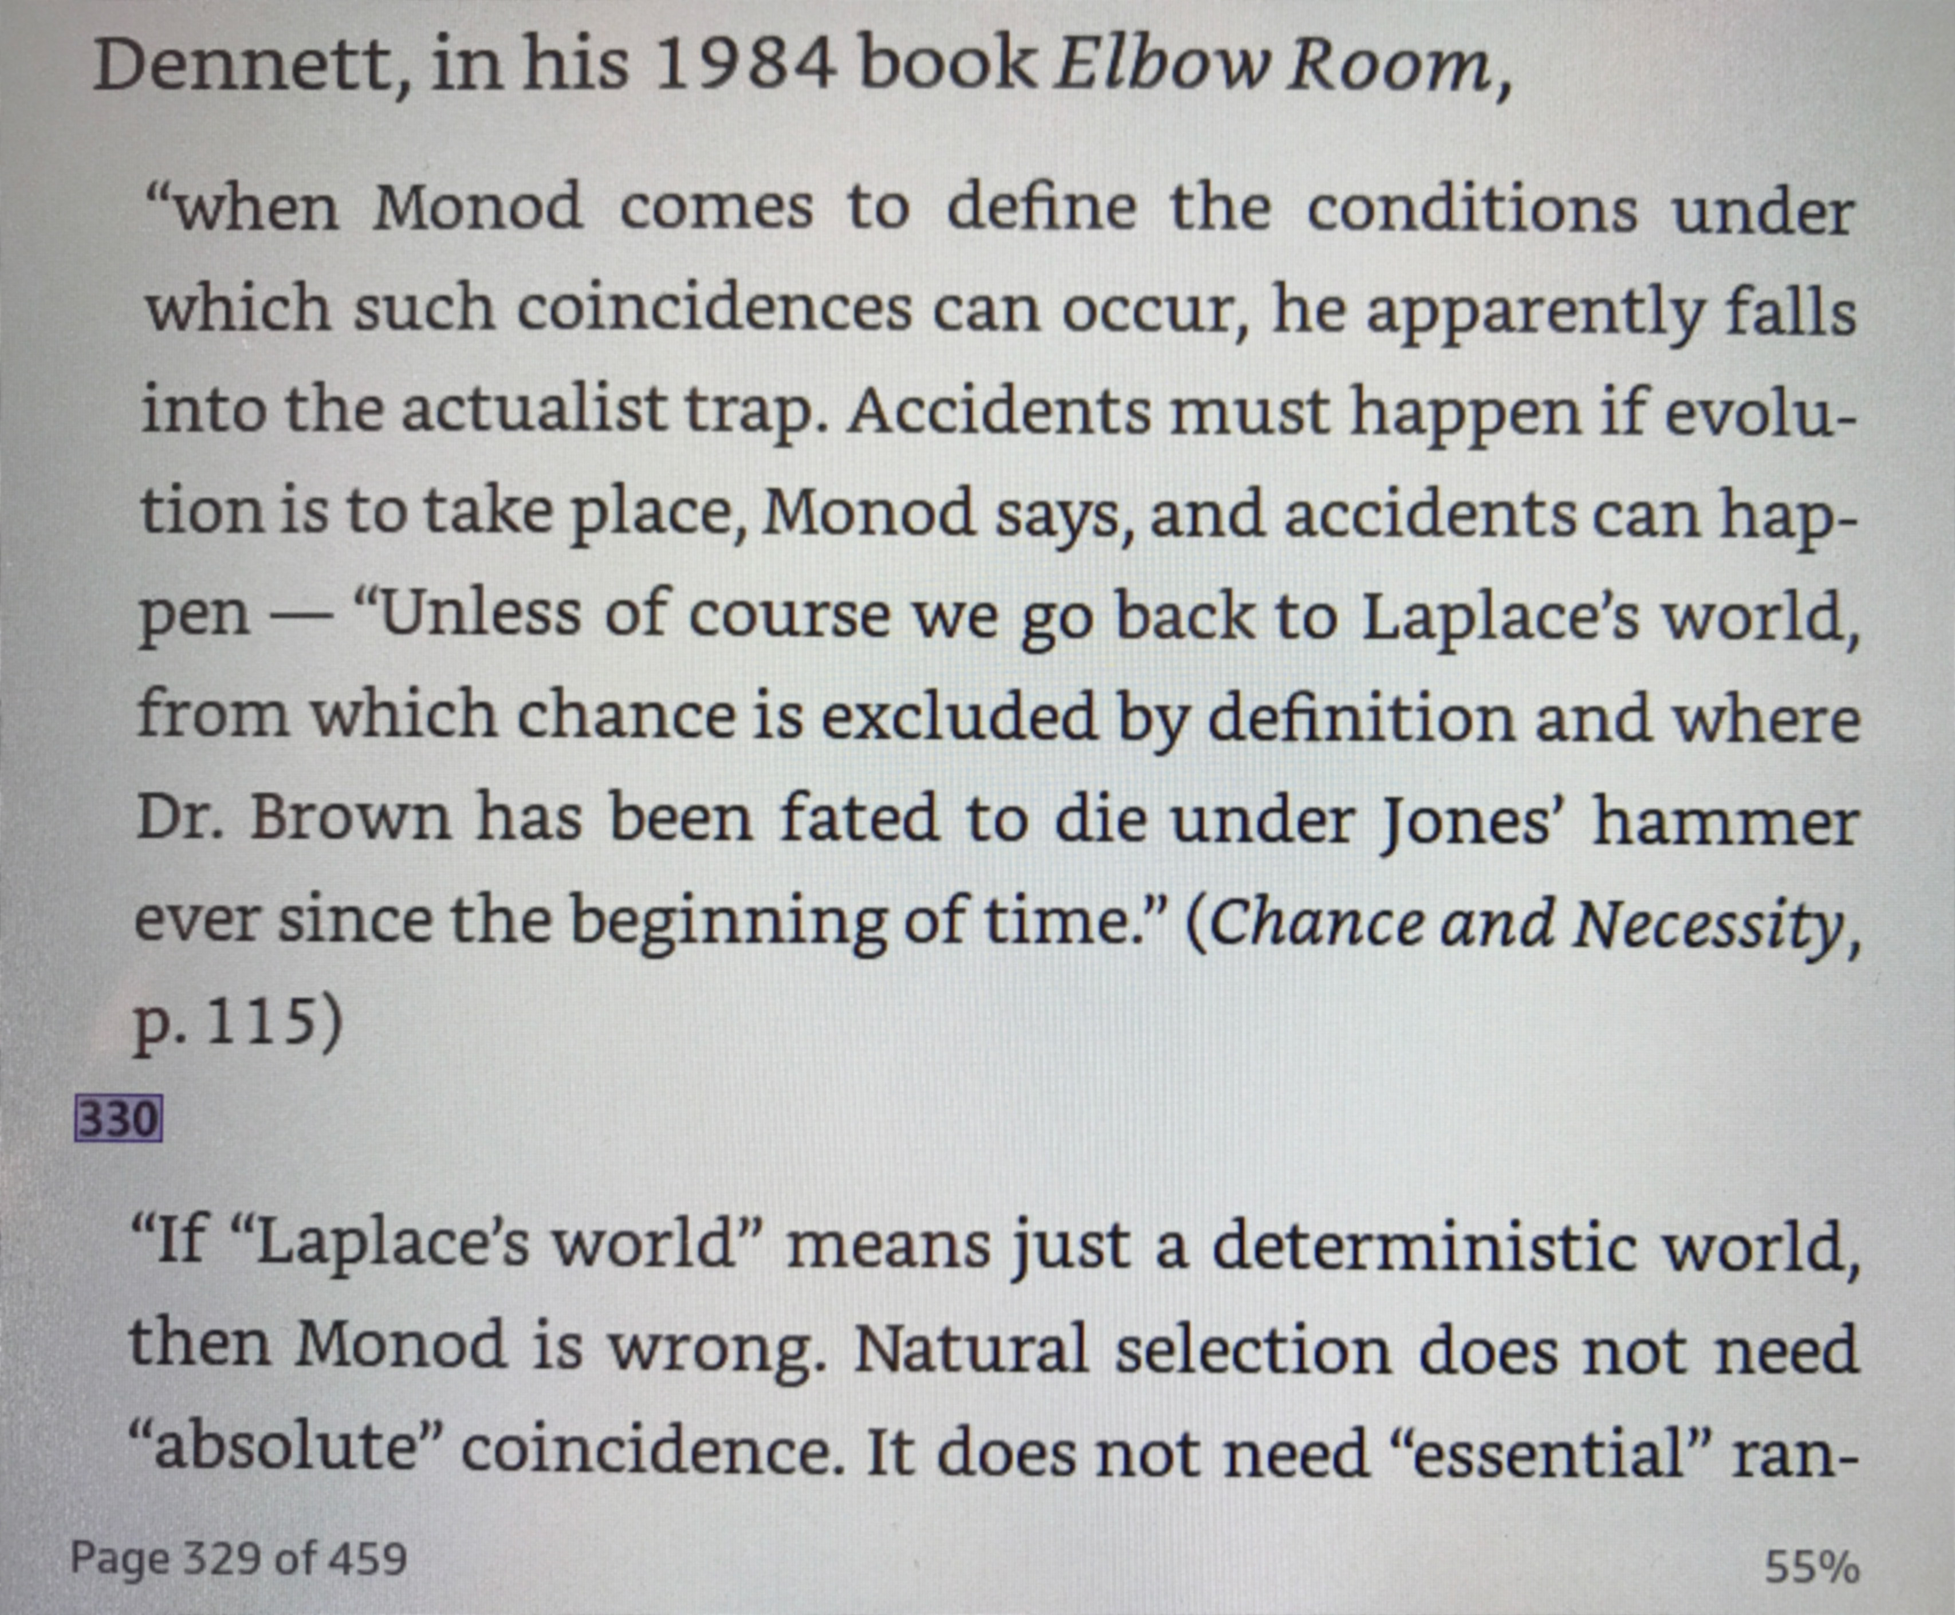
“Go To Page” in Paperwhite and Fire
Kindle Paperwhite (E-ink)
Kindle Fire

Slide 14
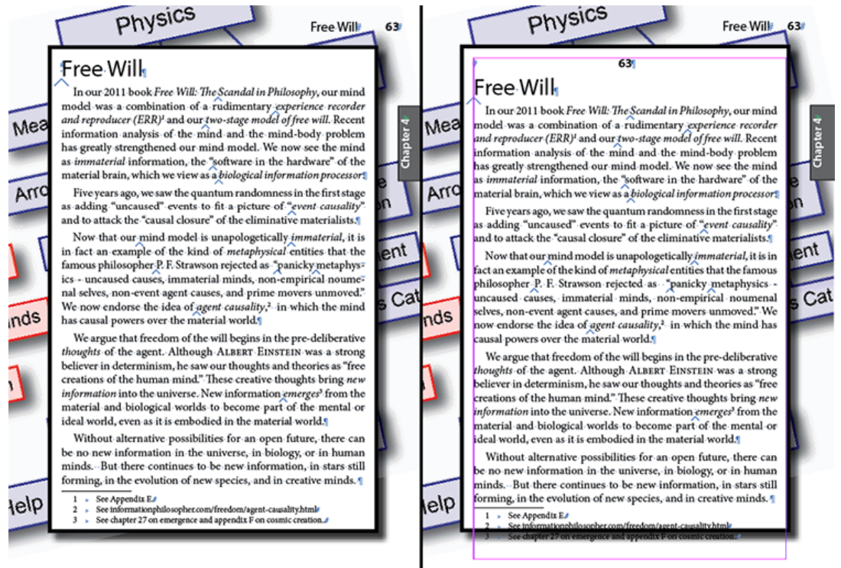
Real Page Numbers as Styled Text (2016)

Slide 15
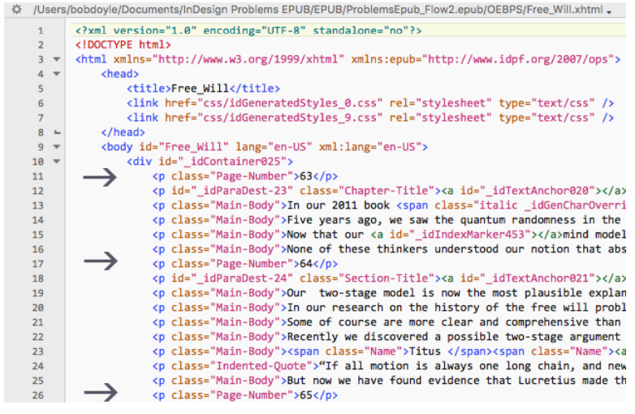
My Real Page Numbers in the XHTML

Slide 16
Why We Need Real Page Numbers
Why do textbook authors/publishers require “real page numbers”?
So readers can know what page they are on.
So scholars can cite the page in academic papers.
So students can be sure they are reading the class assignments.
Note that since a “page” in a book translates into multiple “locations” in a reflowable eBook like the E-ink Kindles, the page numbers in an index topic entry are not actually linked to the page number (whether visible
or invisible) in the eBook.
They are linked to the topic material - as we saw an index marker embedded by InDesign at a specific word. The fact that this link may go to a position in the text that is a few “locations” from the actual page number is not a bug, it’s a feature.
Links go to “relevant paragraphs,” not page numbers, as Amazon requires. A reader can always scroll back a few “locations” to find the page number.
Link to my How-To PDF

Slide 17
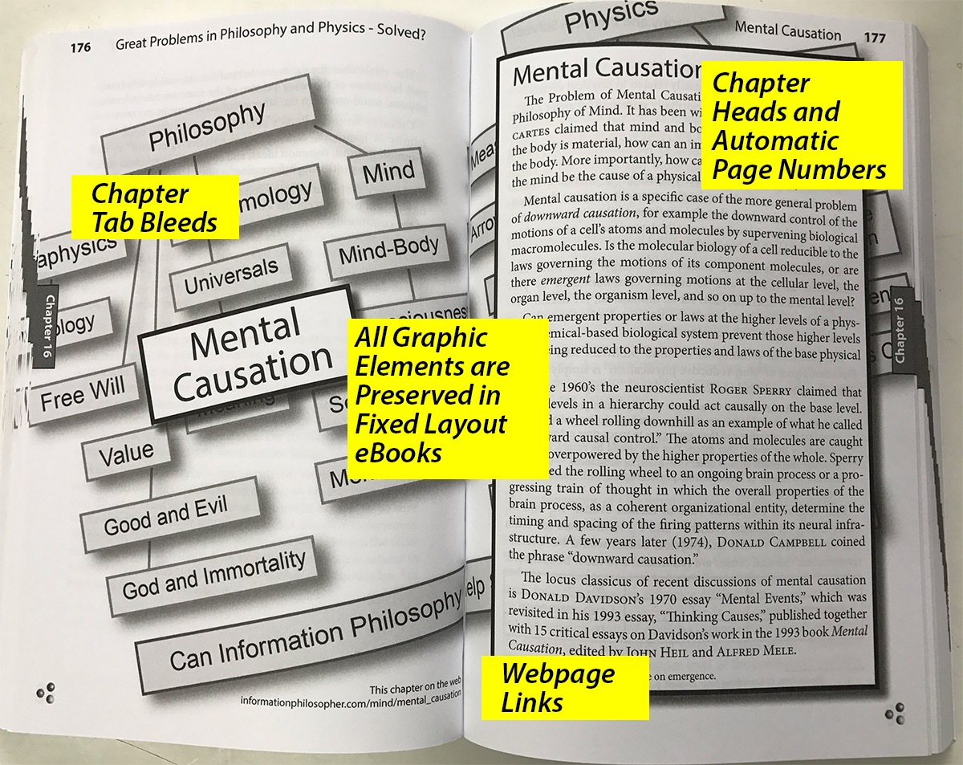
My Print Books Have Some Innovations

Slide 18
My Thanks to Heather Hedden
My first book, Free Will, had only a simple one-level index.
For my second book, Great Problems, I hired Heather Hedden to create a curated, multi-level index.
Heather taught me how to do this myself for my third book, Metaphysics.

Slide 19
My I-Phi Books Are Free PDF Downloads
To reduce costs for students and beginning philosophers, my books can be downloaded as PDFs of chapters or as a whole book.
Go to informationphilosopher.com/books.

Slide 20
Thanks for Inviting Me
Web URL for this Presentation
http://www.informationphilosopher.com/presentations/SSP/

